Slide 1


OOP Project
Payroll management system:
A simple employee salary calculator using Java classes and inheritance.

Slide 2
Project Overview:
Objective: To create a system that calculates and displays employee payments based on different roles and compensation models.
Features:
Input employee data interactively
Supports multiple employee types
Calculates and displays weekly pay
Demonstrates core object-oriented principles

Slide 3
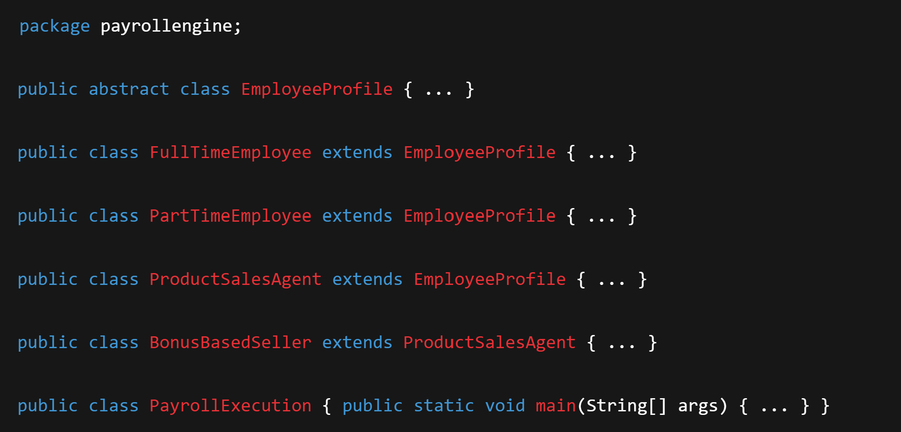
Class Structure:
Each class is part of payrollengine package:

Slide 4
OOP Concepts Demonstrated:
The application demonstrates these exact basic OOP principles:
Abstraction
Inheritance
Encapsulation
Polymorphism
There is a different way to calculate income. So the program uses a class hierarchy to handle this task.

Slide 5
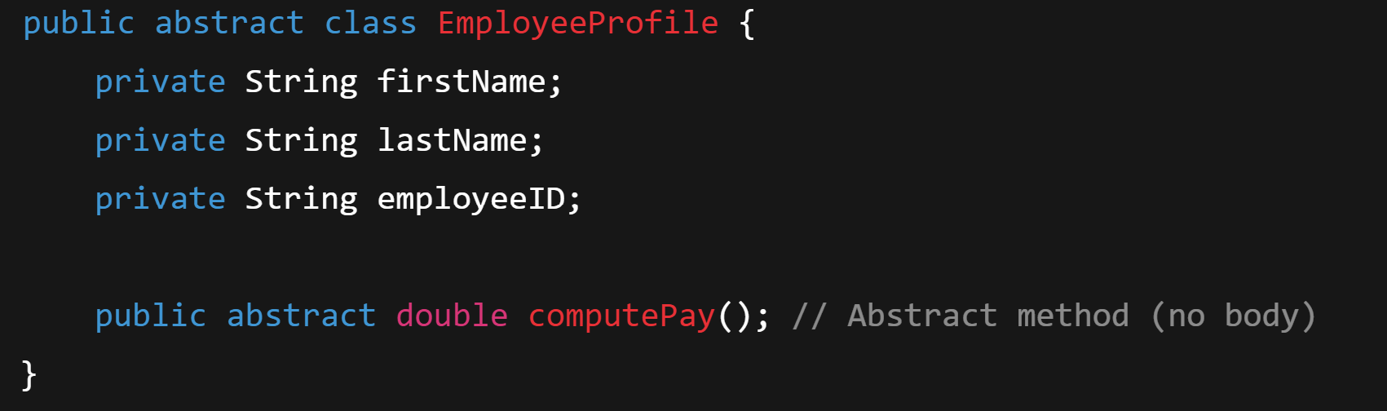
Abstraction:
Abstraction is one of the core principles of Object-Oriented Programming (OOP). It means hiding the complex implementation details and showing only the essential features of an object.
-Abstract class EmployeeProfile, this is the base class for all types of employees.
-It defines common properties (name,ID), it forces subclassesto implement computePay() in their own way, it hides how paying is calculated since different roleshave different ways.

Slide 6
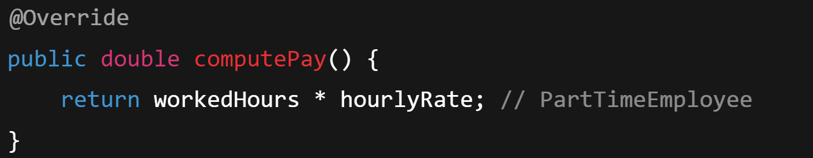
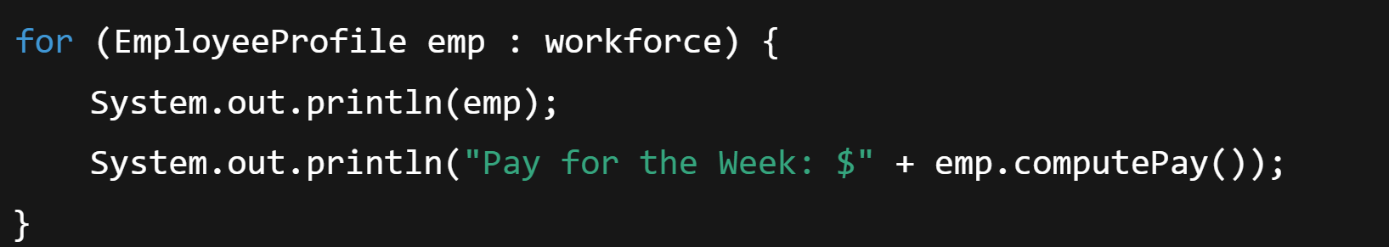
Abstraction:
Subclasses implement abstraction, where each class provides it’s own specific implementation of computePay().
The abstraction in EmployeeProfile allows the main program to treat all employee types uniformly,without knowing how their pay is calculated:
The purpose of this is to implement their own pay logic while hiding details from the main program,which provides a cleaner design,reduces code duplication,and its easier to expand with new employee types.

Slide 7
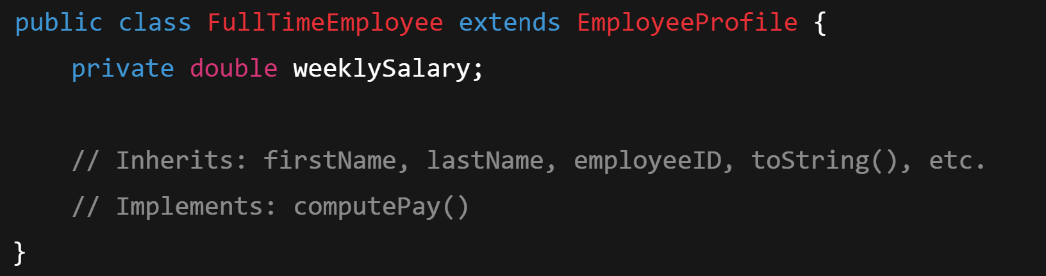
Inheritance:
Inheritance allows a class (subclass) to acquire fields and methods from another class (superclass), promoting code reuse and logical hierarchy.
All employee types inherit from the abstract class EmployeProfile.
ProductSalesAgent itself inherits from EmployeeProfile.
BonusBasedSeller inherits from ProductSalesAgent ,showing multilevel inheritance.

Slide 8
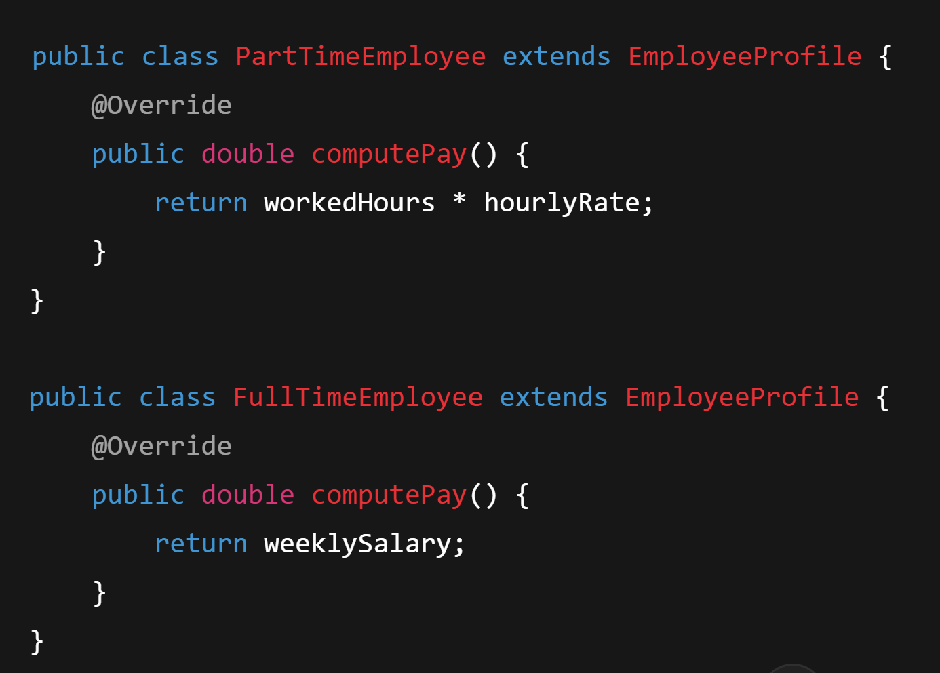
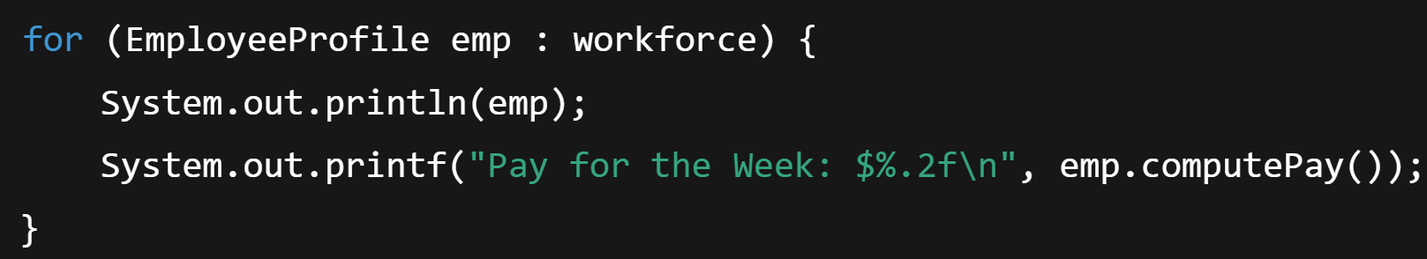
Polymorphism:
Polymorphism means "many forms". It allows objects of different classes to be treated as objects of a common superclass, especially when using overridden methods.
The computePay() method is overridden by each subclass to provide its specific implementation.
and in PayrollExecution:
Even though "emp” can be any type of employee the correct computePay() method is called this is runtime polymorphism.

Slide 9
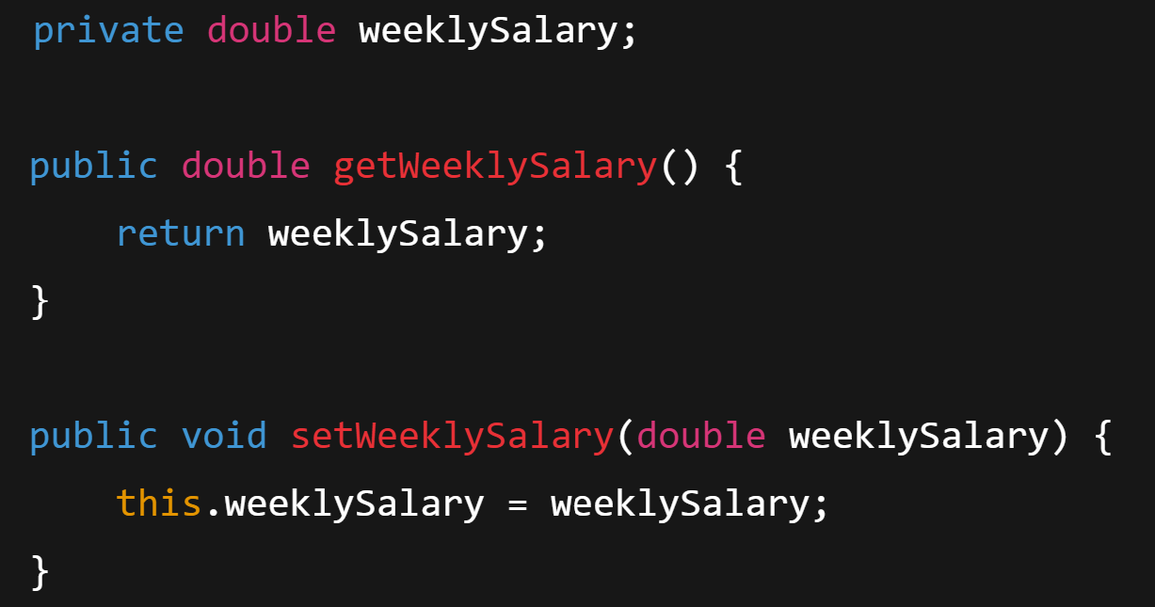
Encapsulation:
Encapsulation is the practice of hiding internal data and requiring interaction via public methods (getters/setters). It protects the integrity of data.
Each class keeps its variables private and exposes them via getters and setters.
In EmployeeProfile, fields like firstName,lastName,employee are private.Access and modification happen only through methods.
Encapsulation allows: 1)Controlled acces to data 2)Prevention of illegal modification
3)Easy debugging and code maintenance.

Slide 10
Conlcusion/Summary:
✅ Demonstrated key OOP principles: Abstraction, Inheritance, Polymorphism, and Encapsulation.
💻 Built a modular and extendable Java payroll system.
👥 Supports multiple employee types: full-time, part-time, commission-based, and bonus-based.
🔁 Easy to update and scale by adding new employee types or features.
📚 Gained practical experience in structuring real-world applications using Java.

Slide 11
Thank you for your attention!
Gersi Hoti

